Slide 1
Auction Planet
Performed by
Kyryl Shestakov

Slide 2

Overview
Auction planet is a free web site designed as an evaluation project at the Epam training course. It provides the functionality of a simple auction where people can post their lots for sale and bid on available lots if so desired.

Slide 3
Functionality
Admin :
-Lot Approval
-Lot Renewal
-Lot Deletion
-Lot Viewing (pending, expired, sold)
User:
-Lot Creation
-Lot Bidding
-Lot Search
-Lot Viewing (available, held, bought)

Slide 4
Use case diagram

Slide 5
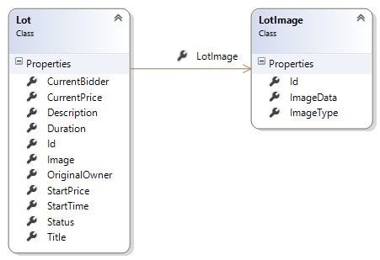
Data models

Slide 6
Application architecture
Controllers, views, viewmodels
Services, data transfer
Repositories, context, entities

